Slide 1
Endre Szemerédi & TCS
Avi Wigderson
IAS, Princeton

Slide 2
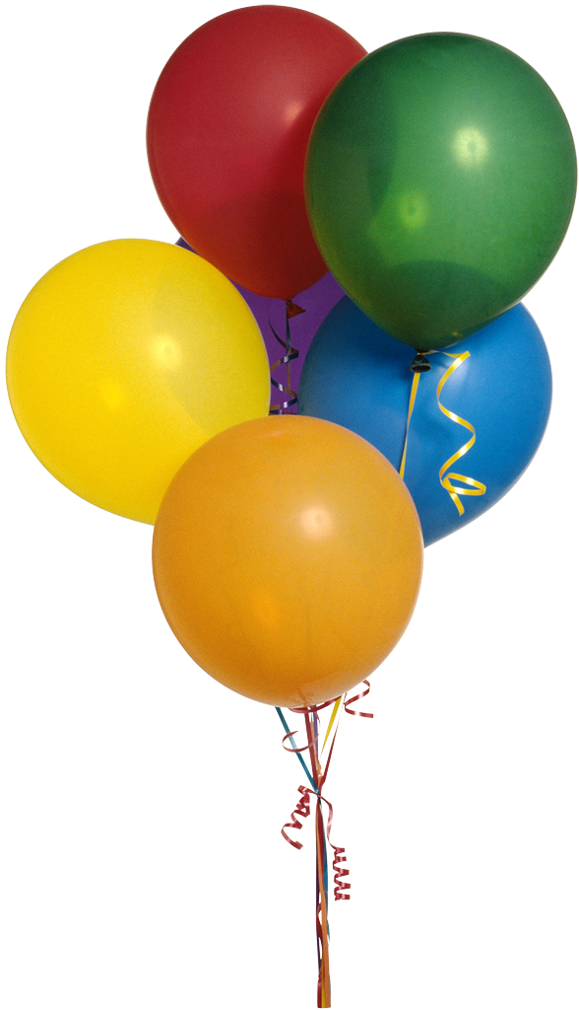
Happy Birthday
Endre !

Slide 3
Selection of omitted results
[Babai-Hajnal-Szemerédi-Turan]
Lower bounds on Branching Programs
[Ajtai-Iwaniec-Komlós-Pintz-Szemerédi]
Explicit ε-biased set over Z_{m}
[Nisan-Szemerédi-W]
Undirected connectivity in (log n)^{3/2} space
[Komlós-Ma-Szemerédi]
Matching nuts and bolts in O(n log n) time
……….
Notes:
.

Slide 4
The dictionary problem
Storage, retrieval, and the
power of universal hashing
Notes:
.

Slide 5
The Dictionary Problem
Store a set U={u₁, u₂, …, u_{n}} ⊆ {0,1}^{k} (n << 2^{k})
using O(n) time & space (each unit is k-bit word).
- Minimize # of queries to determine if x ∈ U?
Classic: log n
Sort U and use a search tree.
u₅ < u_{n} < … < u₇
Question[Yao] “Should tables be sorted?”
Thm[Yao] No! (for many k,n). Use hashing!
Thm[Fredman-Komlós-Szemerédi’82] Never!
2 queries always suffice!
x<u_{i}

Slide 6
h:[2^{k}] → [n]
universal hash
h(x)=ax+b(modn)
h_{i}:[2^{k}] → [n_{i}²]
h₁
n₁
1
n₁²
[2^{k}]
n₂
2
u₁
h₃
h
n₃
u₂
3
h_{i}
u_{n}
i
n_{i}
n_{i}²
h_{n}
- Birthday paradox
Storage: O(n)
Search: 2 queries
n
E[∑_{i} n_{i}² ] = O(n)
Notes:
.

Slide 7
Sorting networks
The mamnoth of all
expander applications
Notes:
.

Slide 8
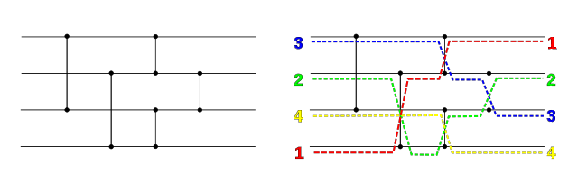
Sorting networks [Ajtai-Komlós-Szemerédi]
n inputs (real numbers), n outputs (sorted)
MIN
MAX
Many sorting algorithms of O(n log n) comparisons
Several sorting networks of O(n log² n) comparators
Thm:[AKS’83] Explicit network with O(n log n)
comparators, and depth O(log n)
Proof: Extremely sophisticated use & analysis of expanders

Slide 9
Monotone Threshold Formulae
n inputs (bits), n outputs (sorted)
1
0
1
0
0
0
1
1
AND
OR
Threshold
Thm: [AKS’83] Size O(n log n), depth O(log n) network.
Cor[AKS]: Monotone Majority formula of size n^{O(1)}
(derandomizing a probabilistic existence proof of Valiant)
Open: Find a simple polynomial size Majority formula
Open: Prove size lower bound >> n² (best upper bound n^{5.3})

Slide 10
Derandomization
The mother of all
randomness extractors
Notes:
.

Slide 11
Derandomized error reduction [CW,IZ]
G explicit d-regular
expander graph
B_{x}
_{{0,1}}^{n}
_{random}
_{strings}
Pr[error] < 1/3
|B_{x}|<2^{n}/3
r₁↓
r↓
r_{k}↓
x→
Alg
x→
Alg
x→
Alg
Majority
Random bits
kn
n+O(k)
Thm[Chernoff] r₁ r₂…. r_{k} independent
Thm[Ajtai-Komlós-Szemerédi’87] r₁ …. r_{k} random path
then Pr[error] = Pr[|{r₁ r₂…. r_{k} }∩B_{x}}| > k/2] < exp(-k)

Slide 12
Derandomization of sampling via expander walks
G d-regular expander.
f: V(G) → R, |f(v)|≤1, E[f]=0
Thm [Chernoff] r₁ r₂…. r_{k} independent in V(G)
Thm [AKS,Gilman] r₁ r₂…. r_{k} random path in G
then Pr[|∑_{i} f(r_{i}) | > εk] < exp(-ε² k)
f: V(G) → M_{d}(R), ||f(v)||≤1, E[f]=0
Thm [Ahlswede-Winter] r₁ r₂…. r_{k} independent
Conjecture: r₁ r₂…. r_{k} random path
then Pr[ ⎜⎜ ∑_{i} f(r_{i}) ⎜⎜ > εk] < d exp(-ε² k)

Slide 13
Black-box groups
and computational group theory
Notes:
.

Slide 14
Black-box groups [Babai-Szemerédi’84]
G a finite group (of permutations, matrices, …)
Think of the elements as n-bit strings (|G|≤2^{n})
Black-box B_{G} representation of G is
x
y
B_{G}
x⁻¹
xy
Membership problem: Given g₁, g₂, …, g_{d}, h ∈ G,
does h ∈ ⟨g₁, g₂, …, g_{d} ⟩ ?
Standard proof: word (can be exponentially long!)
e.g. m=2^{n}, ⟨g⟩ = C_{m ,} h=g^{m/2} = ggggg…….gggggggg
Clever proof: SLP (Straight Line Program)

Slide 15
Straight-line programs [Babai-Szemerédi]
An SLP for h ∈ ⟨S⟩ with S = {g₁, g₂, …, g_{d} } is
g₁, g₂, …, g_{d} , g_{d+1}, g_{d+2}, …, g_{t}=h
where for k>d g_{k}=g_{i}⁻¹ or g_{k}=g_{i}g_{j} (i,j<k).
Let SLP_{S}(h) denote the smallest such t
Thm[BS] Membership ∈ NP
For every G, every generators ⟨g₁, g₂,…, g_{d} ⟩ =G
and every, h ∈ G, SLP_{S}(h) < (log |G|)²
Open: Is it tight, or perhaps O(log |G|) possible?
Thm[Babai, Cooperman, Dixon]
Random generation ∈ BPP

Slide 16
Proof complexity
Resolution of random formulae
Notes:
.

Slide 17
The Resolution proof system
A CNF over Boolean variables {x₁, x₂, …, x_{n}} is a conjunction of clauses f= C₁∩ C₂ ∩ …∩ C_{m}, with every clause C_{i} of the form xi₁ ∪ xi₂ ∪…∪ xi_{k}
Assume f=FALSE. How can we prove it?
A resolution proof is a sequence of clauses
C₁, C₂, …, C_{m}, C_{m+1}, C_{m+2}, …, C_{t}=∅
with (C∪x, D∪x) ⇒ C∪D (Resolution Rule)
Let Res(f) denote the smallest such t
Thm[Haken’85] Res(PHP_{n}) > exp (n)
Thm[Chvátal-Szemerédi’88] Res(f) > exp(n)
for almost all 3-CNFs f on m=20n clauses.
Open: Extend to the Frege proof system.
axioms

Slide 18
The Frege proof system
A CNF over Boolean variables {x₁, x₂, …, x_{n}} is a conjunction of clauses f= C₁∩ C₂ ∩ …∩ C_{m}
Assume f=FALSE. How can we prove it?
A Frege proof is a sequence of formulae
C₁, C₂, …, C_{m}, G_{m+1}, G_{m+2}, …, G_{t}=∅
with (G, G→H) ⇒ H (Modus Ponens)
Let Fre(f) denote the smallest such t
Thm[Buss] Fre(PHP_{n}) = poly(n)
Open: Is there any f for which Fre(f) ≠ poly(n)
axioms

Slide 19
Determinism vs.
Non-determinism
Separators and segregators
in k-page graphs
Notes:
.

Slide 20
Determinism vs. non-determinism in linear time [Paul-Pippenger-Szemerédi-Trotter]
Conj: NP ≠ P ( NTIME(n^{O(1)}) ≠ DTIME(n^{O(1)}) )
Conj: SAT has no polynomial time algorithm
Thm[PPST]: SAT has no linear time algorithm
Cor [PPST]: NTIME(n) ≠ DTIME(n)
Proof:
Block-respecting computation
Simulation of alternating time.
Diagonalization
k-page graphs describe TM computation

Slide 21
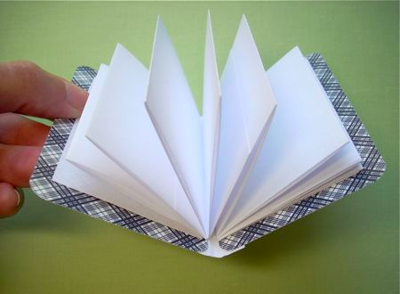
k-page graphs (k constant)
Vertices on spine
Planar per page
k pages
1
2
3
n
Thm[PPST]: k-page graphs have o(n) segregators
( Remove o(n) nodes. Each node has o(n) descendents )
Conj[GKS]: k-page graphs have o(n) separators
Thm[Bourgain]: k-page graphs can be expanders!

Slide 22
Point-Line configurations
& locally correctable codes
Notes:
.

Slide 23
Point-Line configurations
P={p₁, p₂, …, p_{n}} points in R^{n} (or C^{n}).
A line is special if it passes through ≥3 points.
L_{i}: special lines through p_{i}
Thm[Silvester-Gallai-Melchior’40]: If ∀i, L_{i} covers all of P, then P is 1-dimensional ( over C, 2-dim)
Thm[Szemerédi-Trotter’83]: If ∀i, L_{i} covers
(1-ε₀)-fraction of P, then P is 1-dimensional
Thm[Barak-Dvir-W-Yehudayoff’10]: If ∀i L_{i} covers a δ–fraction of P, then P is O(1/δ²)-dim.

Slide 24
Happy Birthday
Endre !

